Slide 1

“Enabling the “Digital Sixth sense” for the visually impaired.”
Hackers: Anca, Ayo, Bogdan, Femi, Medhi, Vaibhav, Wilfrid

Slide 2
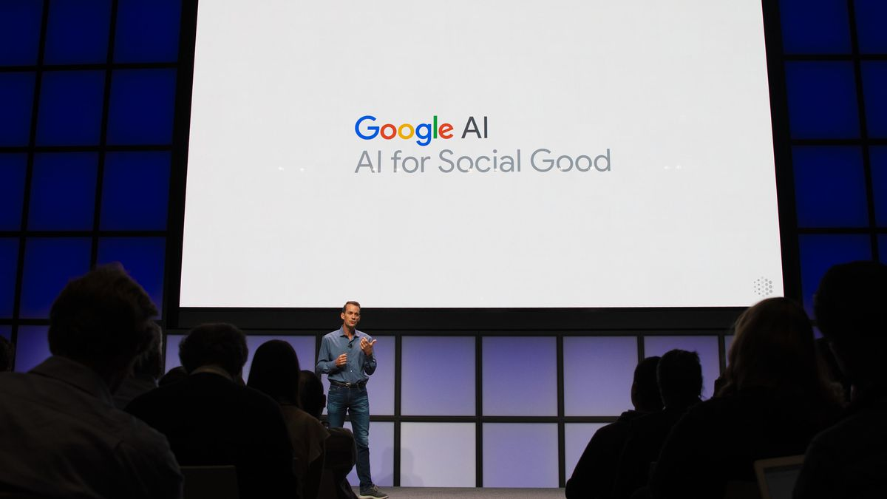

Overview
Challenge
Mission Statement
Solution
Architecture
Future Opportunities

Slide 3



Challenge
Empowering People
Disability
Inclusive Technology

Slide 4


Mission statement
“We enable the visually impaired browse the internet with ease, as we believe in fair and equal access to information”

Slide 5




Solution
Text Summary
Text to Speech
Image Describer
Object Identifier

Slide 6




Architecture
Cloud Functions API
Webpage
Text
NLP
Mobile App
Webpage
Web
Scraper
Image
URLs
Computer Vision
Text to Speech
Google Translate API
Statistical Analysis

Slide 7

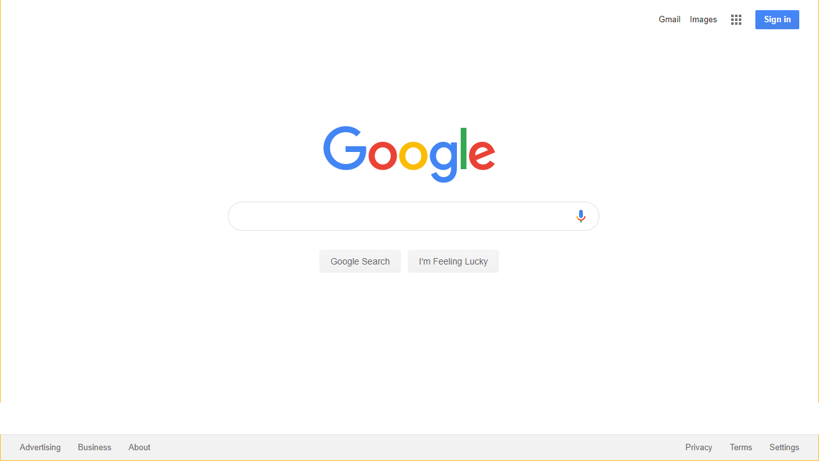

Future opportunities
PRODUCT IMPROVEMENTS
BUILT INTO
ANDROID
CHROME EXTENSION
HARD OF HEARING

